Slide 1
SPP-ICS
Babbu Rai

Slide 2
Agenda
Introduction
SPP-ICS
Need for an ICS SPP
Security Features of The STOE
Threat agents in SPP-ICS
Sources of Vulnerability
Threats Addressed by the STOE

Slide 3
Introduction
The System Protection Profile for Industrial Control Systems (SPP-ICS)
Under Process Control Security Requirements Forum (PCSRF)
High Level Overview.

Slide 4
SPP-ICS
The System Protection Profile for Industrial Control Systems (SPP-ICS) is a set of security requirements for new industrial control systems.
A.k.a. System Protection Profile--Industrial Control Systems Version 1.0

Slide 5
SPP-ICS (Cont.)
Some basic Acronyms in Documents
CC : Common Criteria
STOE : System Target of Evaluation
TSC : TSF Scope of Control
TSF : Technical Security Functions

Slide 6
SPP-ICS (Cont.)
Document Organization :-
Section 1 provides the introductory material for the System Protection Profile.
Section 2 provides general purpose and STOE description
Section 3 provides a discussion of the expected environment for the STOE.
Section 4 identifies the risks to the STOE that have been derived from the statement of the security environment defined in section 3.

Slide 7
SPP-ICS (Cont.)
Section 5 defines the security objectives for both the STOE and the STOE environment.
Section 6 contains the functional and assurance requirements derived from the Common Criteria, Part 2 and 3 [CC2, CC3], respectively that must be satisfied by the STOE.
Section 7 contains guidance information for SST authors who would like to claim conformance to the SPP.
Section 8 provides a rationale to explicitly demonstrate that the identified risks to the STOE have been derived from the aspects identified in the security environment.

Slide 8
Need for an ICS SPP
Recently, several factors have raised concern about the security of industrial control systems. First, there has been a general trend to replace specialized control devices, particularly controllers and communications elements, with general purpose computer equipment and associated data communications technology. Second, many companies have chosen to interconnect certain parts of their process control networks with their corporate intranet once they have introduced general purpose equipment into the process control system.

Slide 9
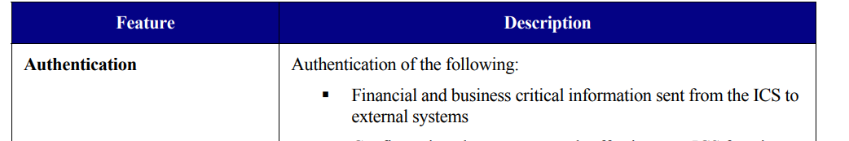
Security Features of The STOE
Authentication, Confidentiality, Integrity, Availability, Boundary Protection , Access control, Backup / Recovery, Audit, Monitoring, Non-interference with safety critical functions, Self Verification, Emergency power, Security Plans, Policies & Procedures.

Slide 10
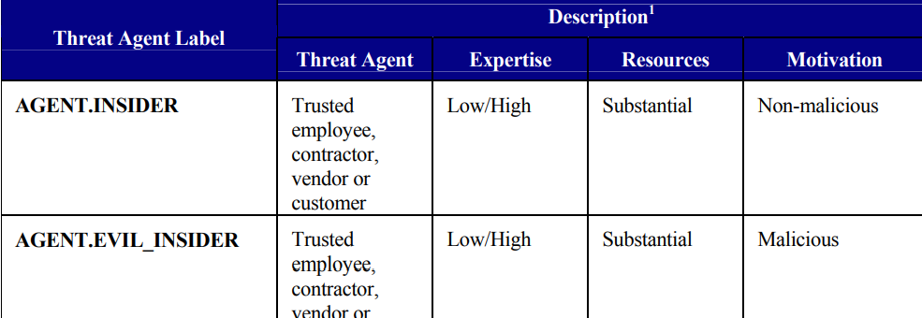
Threat agents in SPP-ICS

Slide 11
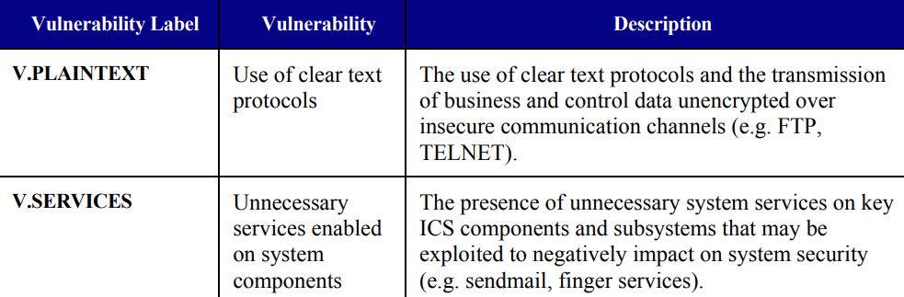
Sources of Vulnerability

Slide 12
Threats Addressed by the STOE
Threat Agents
Sources of Vulnerability
Attack Descriptions
Assets
Threat Description
Organizational Security Policies
Risks
Security Objectives, etc

Slide 13
Thank you
Q/A

